Slide 1

DATA ANALYSIS AND VISUALISATIONS OF INDIAN PREMIER LEAGUE
Nithin Veer Reddy|Sankaranarayanan|Mohan Dwarampudi

Slide 2
INTRODUCTION
The Indian Premier League is a professional Twenty20 cricket league in India contested during March or April and May of every year by eight teams representing eight different cities in India.In this project we want to present some cool,interesting fun facts ,records and results of IPL.
Given the amount of data collected over the years, this is a perfect scenario to do data analysis, mining. The data is structured which makes it all the more effective to perform data analysis. Due to the abundance of data, it enables us to explore the various aspects of data pipeline as well and how it can scale. This can be used in building a distributed data analysis/mining system.
A huge amount of data indicates that Data Visualizations can also be utilized to generate useful insights. This can also be used as an example of knowledge mining. It can also be used as a feedback mechanism for the players which will help them in improving the performance.
These are some of the use cases.

Slide 3
RELATED WORK
Previous work in this domain involved doing Fuzzy Clustering on IPL data for data mining.Fuzzy clustering is an extension of the cluster analysis, which represents the affiliation of data points to clusters by memberships. Introducing fuzziness to clustering gives us the flexible representations of substructures of the data set.There are different shapes of cluster centers and prototypes. Most of them conduct clustering in accordance with similarity or dissimilarity derived from distances, from the centroid of the cluster to data points.
Other work in this domain involved doing Predictive Analysis on the dataset. Examples include analysis on the dependency between winning the toss and batting and whether the decision was successful in the end. It also includes trivial analysis on how strategies can be implemented given the pitch and weather conditions. Some examples include analysis of players in the teams and the correlation between the type of pitch and strengths of the players in the team.

Slide 4
PROPOSED WORK
In this project we are going to build an end to end ETL pipeline to mine the data to extract valuable insights for better visualisations.
ETL Processing will be done via amazon web services data pipeline due to amount of input data.
The ETL Pipeline that we came up with is as follows:
EXTRACT:
Data will be sourced from multiple areas:
Scrapping popular cricket websites.
Kaggle datasets.
Google API - Geo Points.
All the Data is further stored in s3 and will be pushed into DynamoDB.
S3 event invokes AWS lambda which does the data parsing before it is rested in DynamoDB.
DynamoDB will be acting as the source for all the further operations.

Slide 5
PROPOSED WORK
TRANSFORM:
All the semi parsed data will be transformed into JSON format.
Triggers on DynamoDB would invoke AWS Lambda whenever a new entry is added to the DynamoDB.
AWS Lambda transforms the data into meaningful patterns which are later loaded into elasticsearch cluster.
AWS Lambda will also fetch additional geo data through Google API.
LOAD:
Elasticsearch indexes all the incoming data from lambdas.
Data on elasticsearch is split on the nodes in the cluster.
We will storing all the data into three tables namely Matches,Players and Deliveries.
The Data stored in the above three tables will be used to create Dashboards for better visualisation of input metrics.

Slide 6
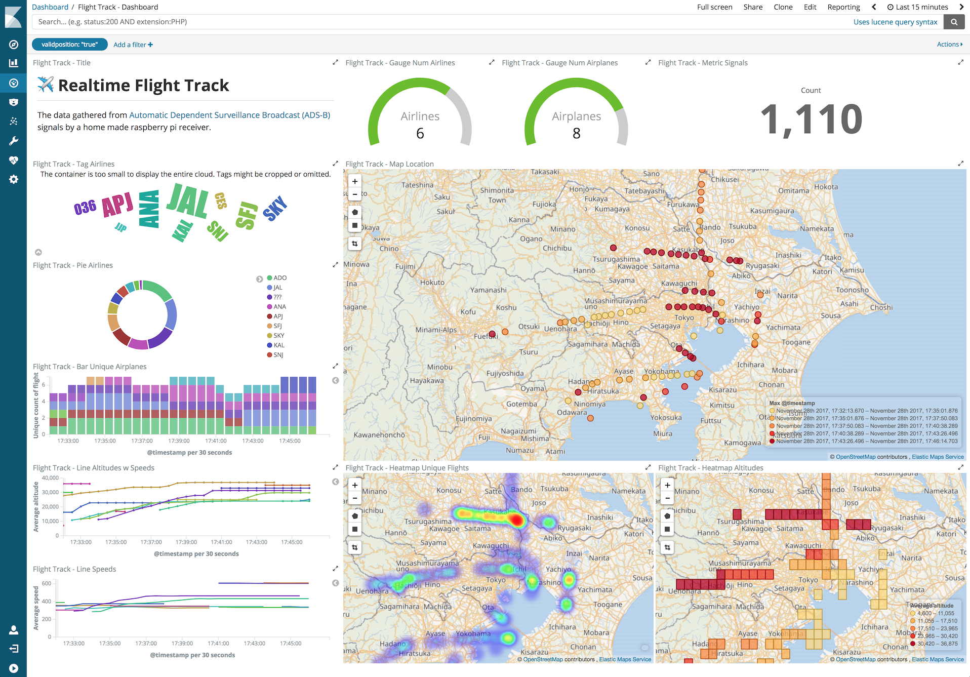
EVALUATION
We will be using kibana to generate dashboards separately for each of the index.
We can apply filters on a visualisation to come up with the required metrics.
We will be generating different visualisations such as Geo Tagging,HeatMaps,Custom Metrics,Pie charts.
Our project end product will be looking similar to the one mentioned below.

Slide 7
MILESTONES
Data Extraction from different sources and storing into S3.
Creating AWS lambda functions to parse the data before loading into DynamoDB.
Transforming the data into JSON Format.
Fetching geo data through Google API.
Transformed data is loaded into elasticsearch cluster.
Indexing the incoming data from lambdas with elasticsearch.
Loading the data into three different tables namely Matches,players and Deliverables.
Generate visualisations separately for each of the tables with the created indices using kibana.
Create the dashboards with the already generated visualisations.
Use NGINX to host the created dashboards.

